Slide 1
WEST SWEDEN Regional food out of the niche
Notes:
We will start by presenting our organisations and how we work in Region Västra Götaland to support the food sector.
(1) tell them who you are, (2) tell them what you want to achieve and (3) tell them what your actions will be during the REFRAME project, according to the 5 steps approach we agreed upon.

Slide 2
Marine environment
….
Notes:
Västra Götaland – one out of three regions in Sweden where agriculture and food is a vital sector with high political priority. Totally 1,6 million inhabitants – 1 million around Gothenburg.

Slide 3
Regional partnership
SÖTÅSEN SCHOOL co-beneficiary
LOCALLY PRODUCED IN WEST co-beneficiary
AGROVÄST coordinating beneficiary
One of six natural resource school governed by the regional authority of Västra Götaland.
Initiates, coordinates and finds
funding for activities and projects
that develops the green sector. Unites research, farming, food producers and society.
Supports small-scale food production
and processing with the aim to
promote trade of locally produced food.
Notes:
AGROVÄST – Our mission is to contribute to a profitable and sustainable farming in West Sweden. We unite research and business. This we do by facilitating an effective dialogue between farmers, food industry and the academy, and by creating possibilities for farmers, industry and the academy to form and attract funding for needs based projects.
Agroväst is working with five RoI-programmes: Dairy, Meat production, Precision farming, Soil conservation and Bioenergy. Each program has a steering committee that represents business, the academy and the public sector. Within each programme we are running a set of development projects. Both smaller studies and field trials, as well as bigger projects often financed by EU.
LPIV – resource center for small-scale food producers. Offers counseling and coaching. Supports events. Regional branding. Coordinates sales activities.
SÖTÅSEN – one of seven schools

Slide 4
A growing demand
”80 % of the Swedes think that origin marking of food is important. Almost as many feel that it is important with Swedish primary products and that the food is produced in Sweden” – Ipsos, Januari 2015
Notes:
Läs texten…
There is a growing demand for swedish and regionally produced food in Sweden.
This is a new origin labelling starting this year, as a response to the increased demand. The initiative comes from Livsmedelsföretagen (food employeers association), Svensk Dagligvaruhandel (association grocery stores) och LRF (farmers association).
We have since earlier a labelling for swedish meat, which has been very successful and is the model for the new label.

Slide 5
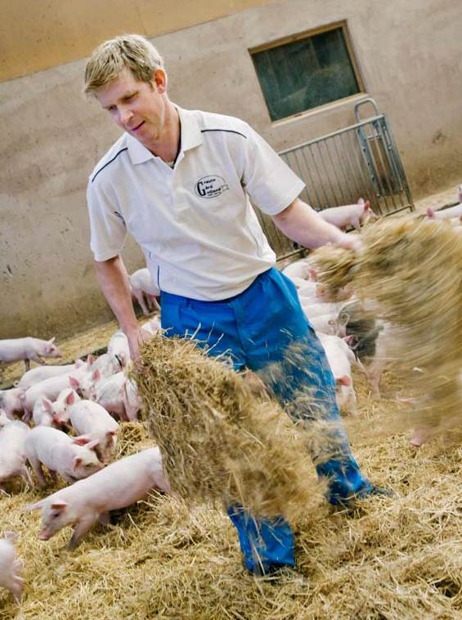
Based on concerns about
Local economy
Environment
Safe and nutritious food
Animal welfare
Notes:
The increasing demand derives from that the consumers want: - To support the farmers and entrepreneurs in the countryside - Open spaces and a vital countryside - Short food chains and less transports - Safe food (low use of hormons, antibiotics and pesticides in the swedish production) - Ethical aspects (good animal welfare. Sweden have very strict regulations)
An example: When IKEA established in Umeå, a city i north Sweden, they recieve intense criticism from customers and media as they in the restaurant served milk produced in south Sweden.

Slide 6
Supporting factors
50% of the grocery stores in Sweden are run as SMEs. They decide themselves which products to buy
Agriculture and food is a regional target area -> better possibilites through funding and org. policies
Food experience part of the regions branding strategy ”Taste West Sweden”
Food awareness as a status symbol
Food scandals, milk crisis…

Slide 7
1. Mapping
Highly developed demand for local food at grocery stores, restaurants and delis.
Demand and supply of products match quite well.
Identified challenges concerns logistics, business approach, volumes and sales.
Focus in this step is to update previous mapping.
Notes:
EVELINA We will not make any bigger efforts when it comes to mapping demand and supply.
We have quite a good picture. Sammanställa befintlig information.
Bugs identified:
effective logistics
common sales organisation
create a better understanding between small producers and purchasers/ procurement officers

Slide 8
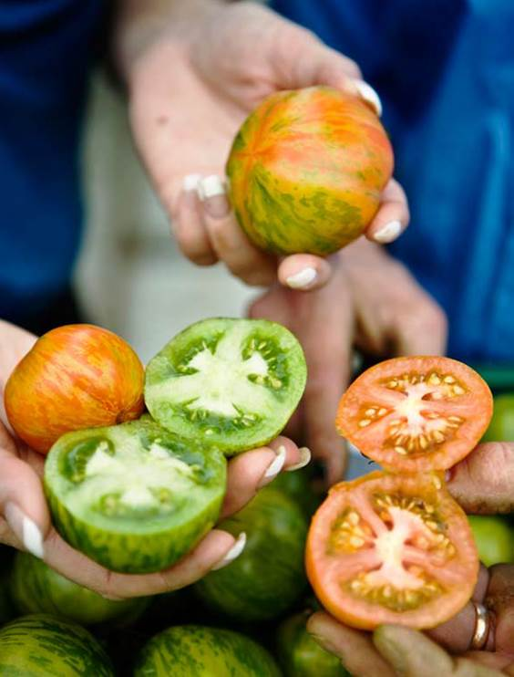
2. Smart specialization strategies
To tailor our rural food supply chain and form a better proposition from the suppliers:
Develop a distribution network of 15 hubs for effective logistics and work with joint marketing and sales.
Give support to 30 food producers adjusting their offer so that it better matches the regional demand.
Establish internal trade between the natural resource schools and hospitals in the region.
Notes:
EVELINA – STINA - CAMILLA
To better meet the large scale demand and help producers to scale up from local to regional, we want to try to tailor our rural food supply chain and form a better proposition from the suppliers. To that end, we will focus on three main activities:

Slide 9
HUBBAR
Marine environment
….
Notes:
Västra Götaland – one out of three regions in Sweden where agriculture and food is a vital sector with high political priority. Totally 1,6 million inhabitants – 1 million around Gothenburg.

Slide 10
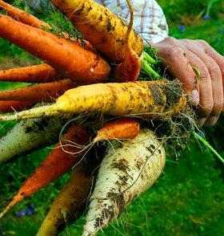
3. Urban intention
Region Västra Götaland have a food strategy.
Strong demand from urban consumers, and a growing interest from the public sector.
Ongoing project to support and inspire municipalities and small regional producers regarding public procurement (not included in our pilot).
Notes:
STINA
Our earlier mapping and experience shows a strong demand from the urban consumers in West Sweden. The positive attitude towards regional food has increased during the last ten years, partly due to a common trend in Sweden considering regional food as healthy, sound and trendy, partly due to consistent work with branding Västra Götaland as a food region (“Taste of West Sweden”).
The county government is coaching municipalities and small-scale food producers to step from “paper strategy” regarding public procurement to real implementation and to get more local food in public kitchens. This activity is not a part of this projects budget, but will still be a part of our REFRAME-pilot. Activities budgeted in this project are focused to get commitment from the hospitals in the region,

Slide 11
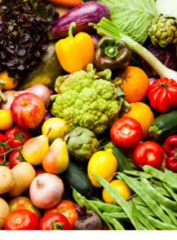
4. Cooperation market
”Locally produced in West” is a kind of RFA.
LPIV supports small-scale food producers and promotes trade of locally produced food.
LPIV also promotes network and cooperation between the producers with focus on sale and marketing.
Focus in this step is to create networks and collaboration between the producers in the areas around the hubs
Notes:
EVELINA

Slide 12
5. Evaluation and improvements
We will register bugs and problems and try to settle them along the way…

Slide 13
Activities per partner
SÖTÅSEN SCHOOL co-beneficiary
LOCALLY PRODUCED IN WEST co-beneficiary
AGROVÄST coordinating beneficiary
Learning environment – from field to fork to field
Coordination
Business support to innovative food producers
Update mapping
Distribution network for effective logistics
Stimulate collaboration among producers

